Slide 1
Minneapolis Preschool Screening Instrument-Revised

Slide 2
Learning Objectives:
Become familiar with the screening tool
Learn how to administer the MPSI-R
How to score the MPSI

Slide 3
MPSI-R Languages Served:
Hmong Form
Chinese, Japanese, Vietnamese, Hindi, Tamil, Bengali, Marathi, Telugu, Tibetan, Korean, Karen
Spanish Form
Portuguese, French, Italian, Russian
Somali Form
Oromo, Amharic, Arabic, Ewe, Swahi
English
Hmong
Somali
Spanish

Slide 4
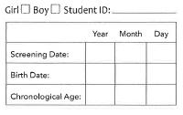
Calculating Age:
Record the testing date:
Year, Month, Day
Record the Birth date:
Year, Month, Day
Age is determined by subtracting birth date form testing date borrowing from months and year columns.

Slide 5
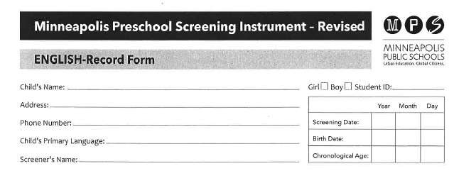
Identifying Information:

Slide 6
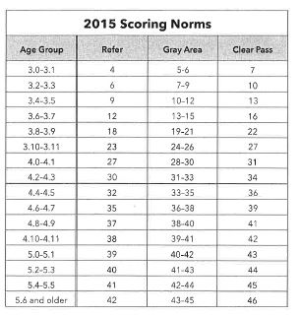
Chronological Age and Scoring:
Record the Screening Date
Record the Birth date
Subtract the birth date from the screening date, borrowing from months and year columns as needed to determine Chronological Age.

Slide 7
Standard Administration
Scores by different examiners must be comparable
Examiner must use exact wording as underlined in manual
Give additional instructions to child only on demonstration items and only as directed in manual
Repeat items only if child appears not to hear
Always speak slowly and distinctly

Slide 8
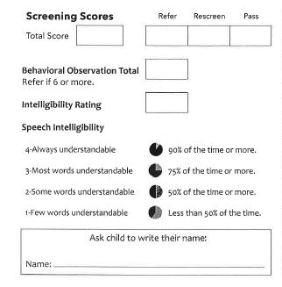
MPSI-R Scoring
*“1” correct “0” not correct – Blank only if you can not administer
Record 3 total scores:
Screening Total
Behavior Total
Speech Intelligibility
(Behavior Screener and Speech Intelligibility optional)

Slide 9
Overview of Administration Procedures
Scoring
*“1” correct “0” not correct – Blank only if you can not administer
Record 3 total scores:
Screening Total
Behavior Total
Speech Intelligibility
(Behavior Screener and Speech Intelligibility optional)

Slide 10
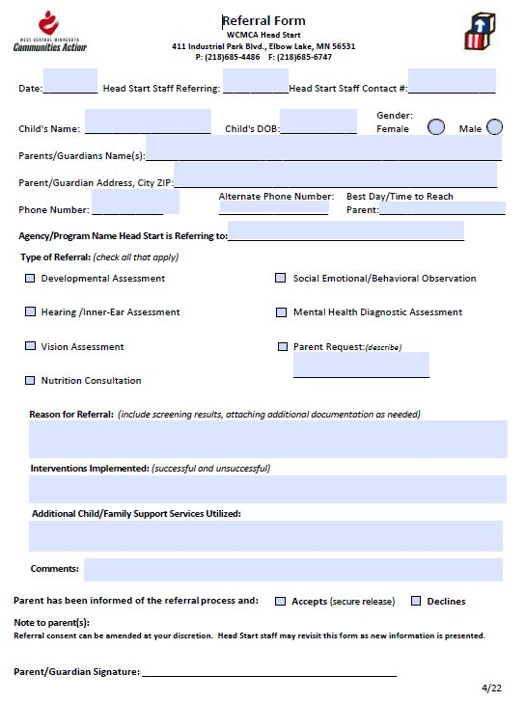
Making A Referral Teachers will complete a developmental referral for all children whose score is in the “Refer” range.

Slide 11
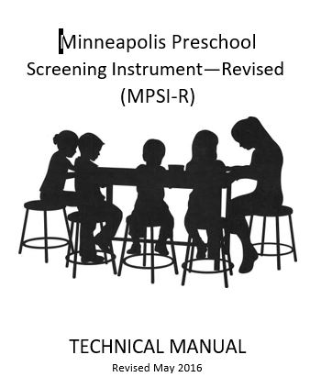
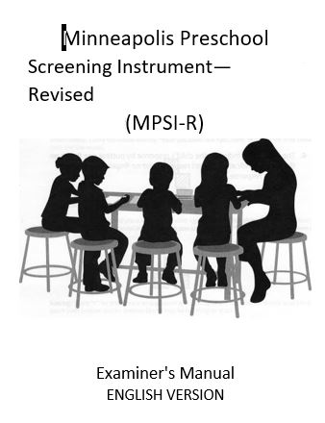

Slide 12
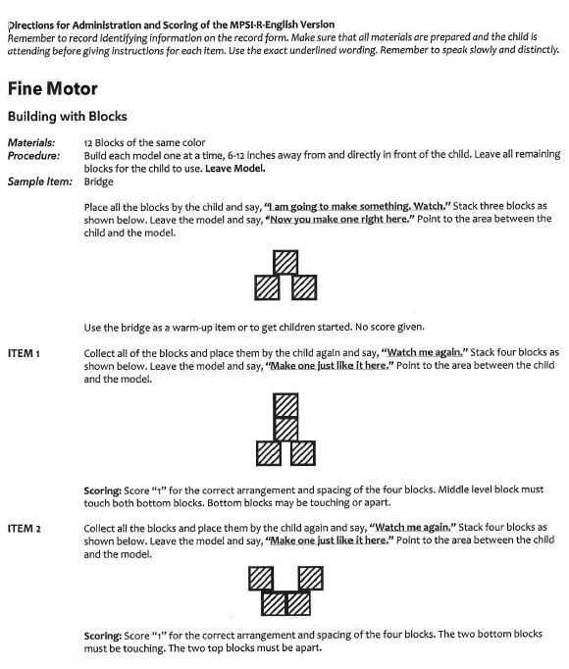
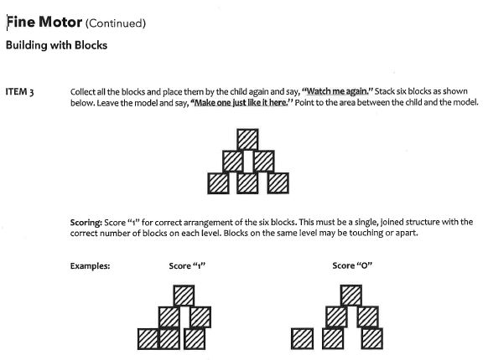

Slide 13
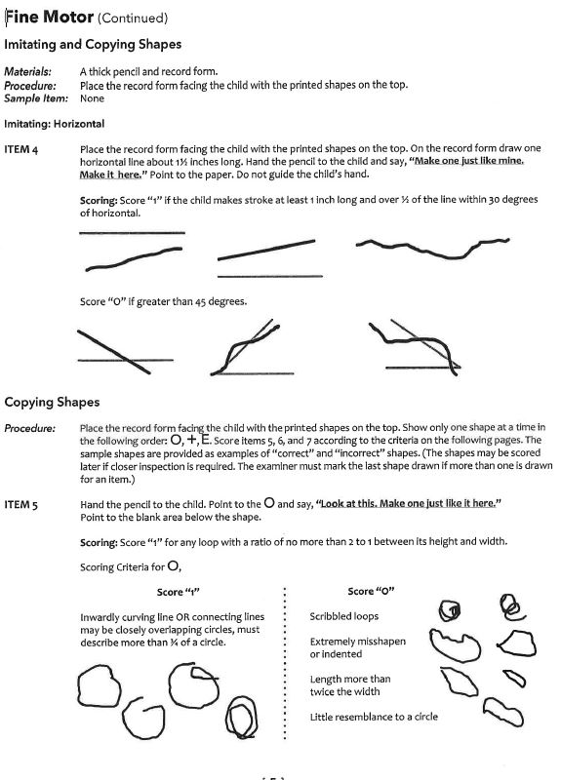
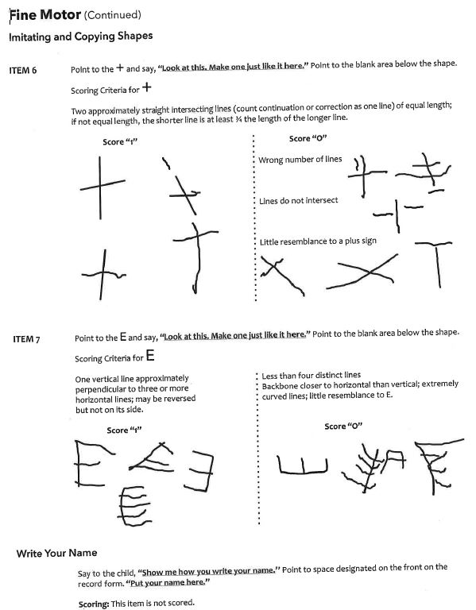

Slide 14
Video Link of MPSI-R Administration
MPSI Demo

