Slide 1
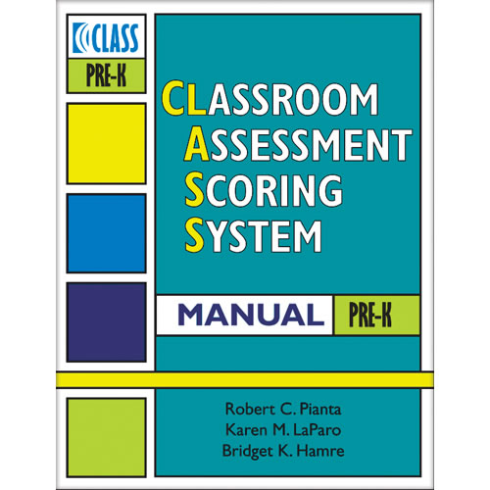
UNDERSTANDING CLASS

Slide 2
What is the CLASS?
The Classroom Assessment Scoring System© (CLASS)
is a research-based observation tool used to help teachers and
schools improve the quality of classroom interactions.

Slide 3
What is the CLASS?
CLASS measures:
The quality of classroom interaction processes
The overall classroom experience based on all adult and child participants

Slide 4
What is the CLASS?
CLASS observations are conducted in 4 or more cycles.
A cycle consists of:
one 20-minute observation period
one 10-minute recording period

Slide 5
How is the CLASS observation instrument
organized?

Slide 6
Organization of the CLASS instrument
Classroom Quality
Emotional Support
Classroom Organization
Instructional Support

Slide 7
CLASS-AT-A-GLANCE
Domains
Emotional Support
Classroom Organization
Instructional Support
Positive relationships among teachers and children, teachers’ abilities to support social and emotional functioning in the classroom
Well-managed classrooms that provide children with frequent, engaging learning activities
Interactions that teach children to think, provide ongoing feedback and support, and facilitate language development
Each domain includes Dimensions, Indicators and Behavioral Markers that focus on various aspects of adult-child interactions.

Slide 8
CLASS-AT-A-GLANCE
EMOTIONAL SUPPORT
CLASSROOM ORGANIZATION
INSTRUCTIONAL SUPPORT
Positiv e Climate
(4 Indicators)
Behavior Management (4 indicators)
Concept Dev elopment (4 indicators)
Negativ e Climate
(4 indicators)
Productiv ity
(4indicators)
Quality of Feedback
(5 indicators)
Teacher Sensitiv ity
(4 indicators)
Instructional Learning Formats
(4 indicators)
Language Modeling
(5 indicators)
Regard for Student Perspectiv es (4 indicators)

Slide 9
EMOTIONAL SUPPORT
DIMENSIONS
How teachers help students develop:
Warm, supportive relationships with
teachers and peers
Positive Climate
Enjoyment of and excitement about
learning
Negative Climate
Feelings of comfort in the classroom
Teacher Sensitivity
Appropriate levels of autonomy
Regard for Student Perspectives

Slide 10
Emotional Support
Classrooms have a positive climate when teachers and students:
Have positive relationships and clearly enjoy being with each other
Children are excited about learning and spending time in the classroom
Are respectful of one another

Slide 11
Emotional Support
Classrooms have a negative climate when teachers and students:
Demonstrate frequent irritation with each other
Negative situations escalate and the teacher is unable to diffuse them
When there are examples of threatening or bullying behaviors, when there is frequent teasing or humiliation, or when harsh punishment is used.

Slide 12
Emotional Support
Teachers are sensitive when:
They know their students well enough both academically and socially to be aware of and respond to their needs.
Children are comfortable enough to freely participate and take risks, seeking adult support and guidance when needed

Slide 13
Emotional Support
Teachers who demonstrate a high regard for student perspectives:
Are flexible in incorporating children’s interests and ideas in their learning activities
Encourage children to express their ideas
Foster independence and responsibility

Slide 14
CLASSROOM ORGANIZATION
DIMENSIONS
How teachers help students:
Develop skills to help them regulate
their own behavior
Behavior
Management
Get the most out of each school day
Maintain interest in learning activities
Productivity
Instructional Learning Formats

Slide 15
Classroom Organization
Teachers in classrooms that score high on
behavior management:
Have clear rules and expectations that are consistently reinforced.
Are proactive in anticipating difficulties
Reinforce the positive behaviors and redirect
unwanted behaviors

Slide 16
Classroom Organization
Teachers in classrooms that score high on
productivity:
Maximize learning time by having clearly defined learning activities ready for children so transitions are brief, there is little waiting and few disruptions
Have routines that children know and follow throughout the day
There is little wandering in the productive classroom

Slide 17
Classroom Organization
High quality instructional learning formats
can be seen in classrooms where:
Teachers actively facilitate children’s involvement in activities
They use a variety of materials and modalities to teach
Children are focused and actively involved in lessons
Learning objectives are clear

Slide 18
INSTRUCTIONAL SUPPORT
DIMENSIONS
How teachers help students:
Learn to solve problems and think
creatively
Concept Development
Get individualized feedback about their learning
Quality of Feedback
Develop more complex language
Language Modeling

Slide 19
Instructional Support
Teachers who score high in concept development:
Intentionally sustain interactions that deepen and expand understanding
Ask “why” and “how” questions to encourage analysis and reasoning
Integrate new ideas into previous knowledge and connect it with real-world applications

Slide 20
Instructional Support
Teachers who score high in providing
quality of feedback:
Focus on the process of learning rather than getting the “right answer”
Provide children with specific information about their work by expanding and clarifying ideas
Ask follow-up questions to help deepen understanding

Slide 21
Instructional Support
Teachers who score high in language modeling:
Participate in frequent conversations
Ask open-ended questions
Repeat, extend and elaborate children’s
responses
Use advanced language that contains a variety of words.

Slide 22
CLASS Resources
CLASS Manual –PreK
CLASS Dimensions Overview
Pre-K CLASS Dimensions Guide
CLASS Strategy Cards
CLASS Dictionary
Teachstone-CLASS Video Library
Early Childhood Knowledge and Learning Center (http://eclkc.ohs.acf.hhs.gov/hslc)

Slide 23
Adapted from a presentation created by Los Angeles County Office of Education, Head Start State Preschool and the
Classroom Assessment Scoring System Manual, Pre-K, Robert C. Pianta, Karen M. LaParo, Bridget K. Hamre

